Slide 1
Dungeon Escape room
Frank Keith
Clarissa Woodberry

Slide 2
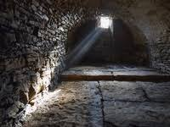
Reflection
How did we work as a team?
Generally well - used slack to communicate - bit of confusion over flow chart
Focused communication
Generally good at time management
Benefitted from experience working together this week separated tasks between us well

Slide 3
Reflection
What went well?
Focused on MVP at first - we learnt from the ‘cup of tea instructions’ project
Clear about what parts of the escape room we were both doing
Liaised well out of course hours
We agreed on escape room idea quickly

Slide 4
Reflection
What we’d improve/change for next time
Perhaps slightly too ambitious in terms of escape room tasks given time limit
Difficulties downloading Scratch made it harder to swap as much as we wanted to
Perhaps be clearer at the beginning about what we needed to produce alongside the escape room (presentation and flow chart)

Slide 5
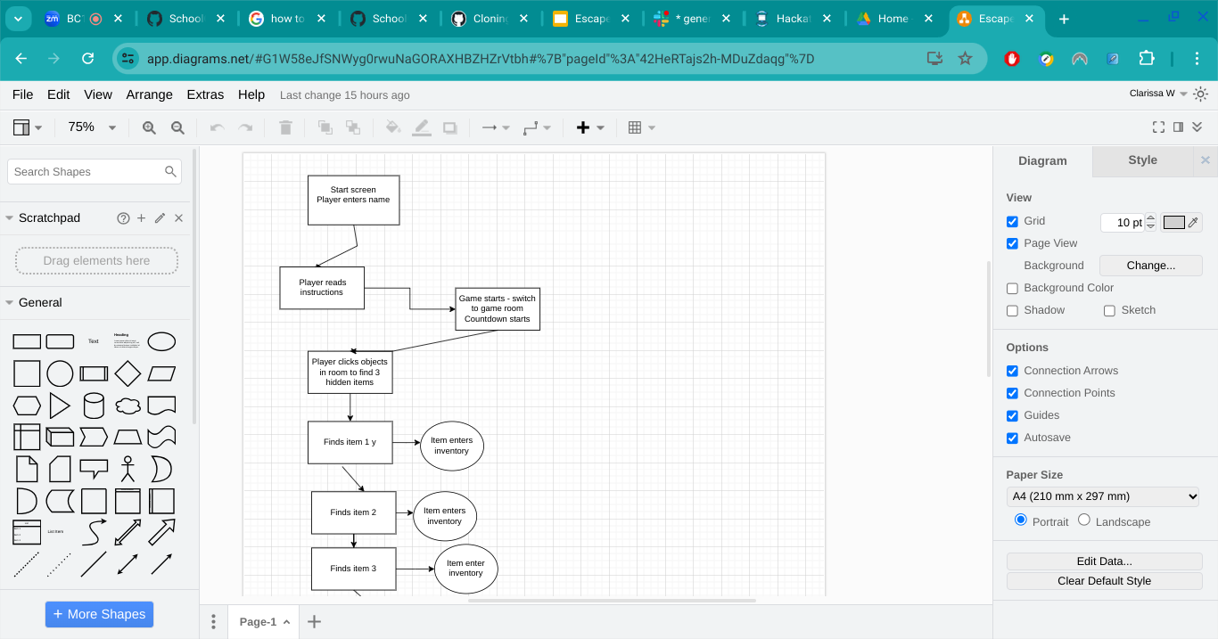
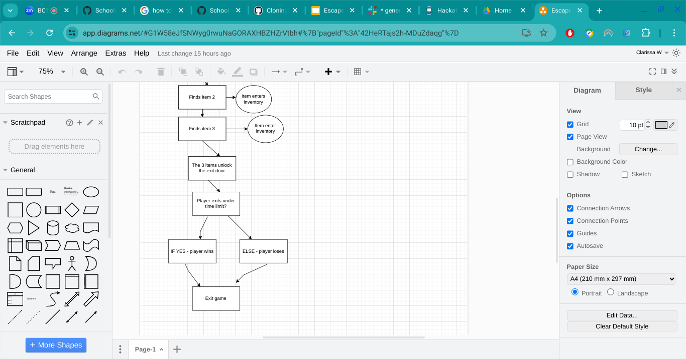
Flow diagram
Clarity
Uncertain about the level of detail
Escape room doesn’t follow linear process - harder to show in flow diagram

